Slide 1
WinForms on ARM64 with .NET 7

Slide 2

Stefan Koell Co-Founder & CEO Royal Apps GmbH
e: stefan.koell(-at-)royalapps.com m: @stefankoell@dotnet.social t: @stefankoell g: github.com/StefanKoell

Slide 3
About Royal TS https://www.royalapps.com/ts/win/features
- WinForms, C# - Offers RDP, VNC, Terminal (SSH), Web, and more - Cross-Platform Codebase (Windows, macOS, mobile) - DI, Messaging, High-DPI, SVG, UI Theming - .NET Framework -> .NET 5, 6, 7

Slide 4
Why WinForms?
- First release 2003 - Interop / Win32 access - 3rd party component ecosystem - UWP/WinUI issues and maturity - Rewrite is expensive - Maybe WPF/Avalonia

Slide 5
ARM64 What / Why?
- SoC - High Performance - High Efficiency - Great Battery Life - Low Heat/Noise

Slide 6
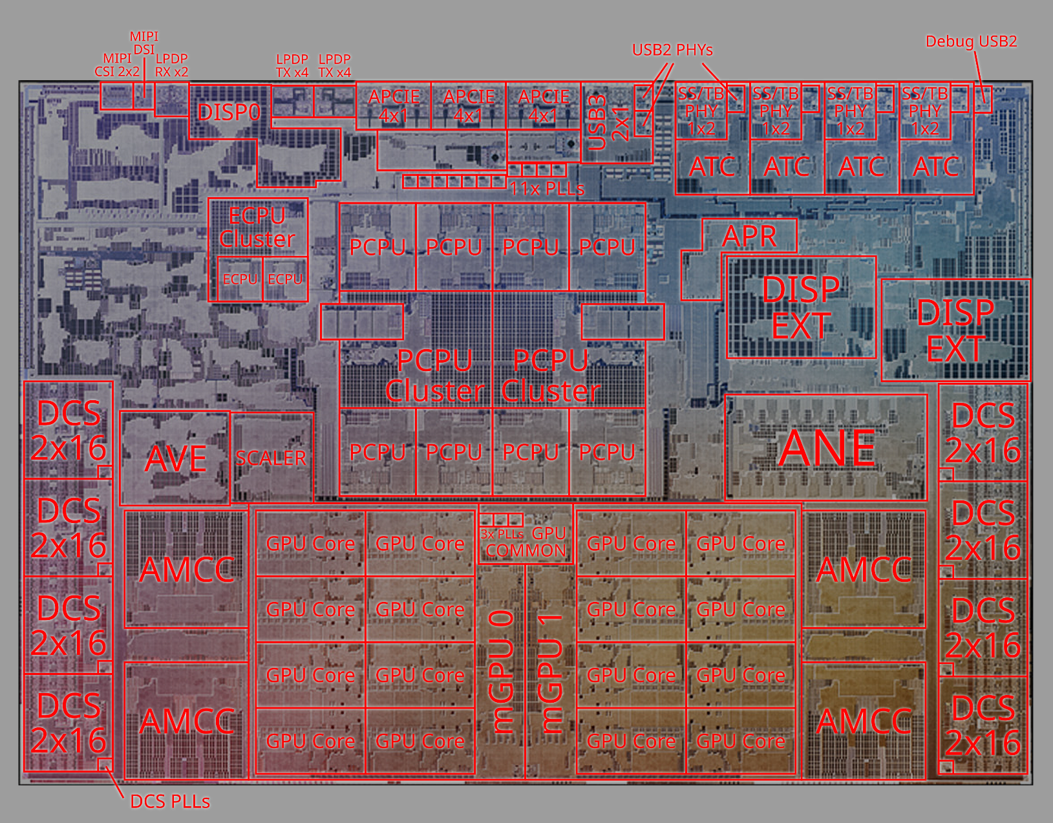
M1 Pro SoC
AVE = Apple Video Encoder
APR = Apple ProRes
ATC = Apple Type C
ANE = Apple Neural Engine
APCIE = Apple PCIe
AMCC = Apple Memory Cache Controller (SLC)
DCS = DRAM Command Scheduler? (LPDDR5 channel PHY/backend)
LPDP = Low Power DisplayPort
MIPI CSI = MIPI Camera Serial Interface
MIPI DSI = MIPI Display Serial Interface
DISP = Embedded display controller
DISP EXT = External display controller
mGPU = GPU cluster (Cores, Tile Accelerator, MMU, pixel load/store stuff, etc.)

Slide 7
Windows on ARM
WoA
- "special" Windows SKU - Intel Bridge (Windows 11 only!) vs Rosetta 2 (macOS) - Licensing - Windows Insider - Parallels/VMware Fusion on Apple M1/M2

Slide 8
Hardware
- Ultrabooks / Notebooks - Microsoft: Surface Pro 9 and X - Lenovo: Flex, Thinkpad - HP: Elite Folio - Acer: Spin 7 - Project Volterra (link) - Ampere Computing (link) - Apple: M1/M2 with Parallels/vmware Fusion

Slide 9
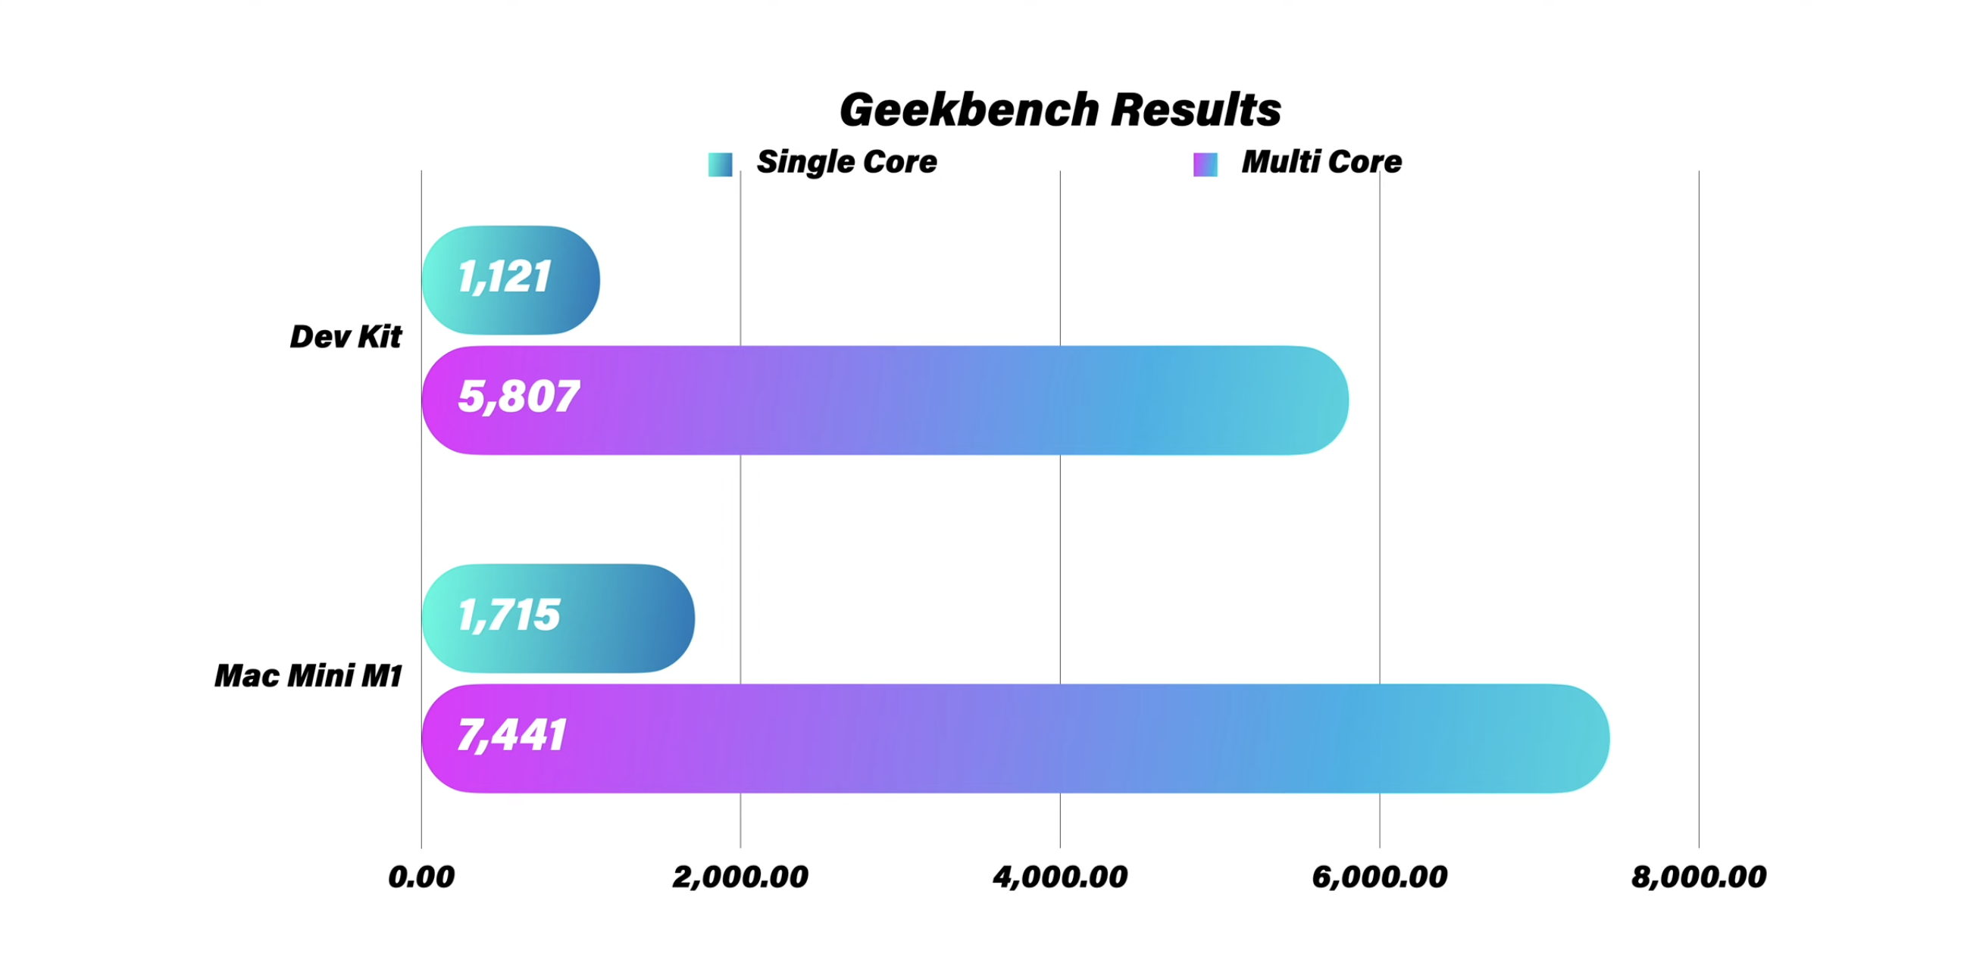
Benchmarks
https://www.youtube.com/watch?v=cIOZuY-fi5E

Slide 10
Software supporting ARM64
- Windows 11 - .NET 7 - Visual Studio 2022 - JetBrains Rider - VS Code - Edge

Slide 11
NuGet Packages
- Using pure (.NET only) packages - Using packages with native binaries - Creating packages with native binaries: - Use compiler directives (#if) - Use RuntimeInformation API (link)

Slide 12
Royal TS for ARM64
- Any CPU vs x64 vs ARM64 - PInvoke Considerations - 3rd Party Dependencies - Self Contained - CI/CD Pipeline (nuke) - Build ARM64 artifact on x64 (Build Server)

Slide 13
Real World Performance
x64 Machine 16-core Ryzen 9 5950X 3.4GHz 64GB RAM | ARM64 VM * 8-core Apple Silicon 3.2GHz 24GB RAM | MacBook Pro VM ** 8-core i9 9980HK 2.4GHz - 5.0GHz 16GB RAM | MacBook Air VM *** 6-core Apple Silicon 3.2GHz 16GB RAM
Compile Time: ~ 12s Startup Time: ~ 8s | Compile Time: ~ 15s Startup Time: ~ 8s | Compile Time: ~ 35s Startup Time: ~ 11s | Compile Time: ~ 27s Startup Time: ~ 11s
* Mac Studio 2022 64GB 10-core M1 Max ** MacBook Pro 2019 32GB 8-core i9 9980HK
*** MacBook Air 2022 24GB 8-core M2

Slide 14
Thank you!
Btw, we're hiring! ;) https://royalapps.com/jobs
e: stefan.koell(-at-)royalapps.com m: @stefankoell@dotnet.social t: @stefankoell g: github.com/StefanKoell

